Slide 1
Austine Gwa smart Disease outbreak detection system

Slide 2
Developer
AUSTINE GWA SIT/B/01-02699/2016

Slide 3
CHALLENGE / problem
Outbreak of diseases has been a problem in many communities
Mostly to the communities where acces to current information is a big deal. While most deadly disaeses like cholera, typhoid , TB etc always break out and destroy lives without being realized as soon.
These disease outbreaks need to be realized and fought in due time.

Slide 4
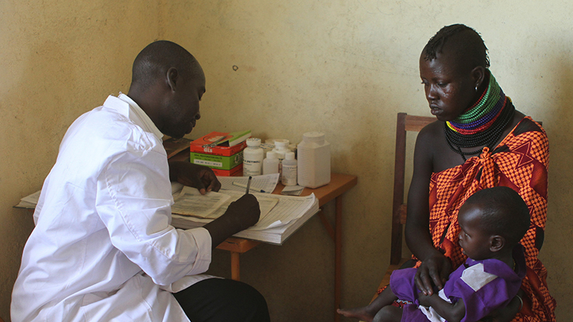
CHALLENGE 2
Notes:
Current system used by major Dispensaries

Slide 5
Solution
My solution to this problem comes in 3 easy steps.
Automate patient health data collection
Store all data for all patients from a specific community in one data center
Automate a daily analytics on this data to determine the number , type and area of diseases recorded in a single day

Slide 6
THE PERSONNA (Who are the beneficiaries?)
Health workers at Health facilities.
They use the system will help the health workers to determine disease outbreaks in time and act on them accordingly
Villagers (common mwananchi)
They can access already analyzed data from the system from anywhere at anytime. This will help them know the diseases that are deadly and common around their proximity.

Slide 7
HOW IT WORKS
When A patient goes to the hospital a diagnosis of all the diseases is done on him/her (at her will )
This data is then recorded into our system at the hospital and then the system automatically syncs it to the online database at the data center via our restful web service.
Upon reaching the datacenter an automatic urnalisis is done on the data and the system adjusts accordingly
This data is then purblished to our website and mobile applications

Slide 8
HOW IT WORKS
Primary data collection
Doctors and Nurse
Pushed to the data center
Automatic Synchronization of data
Performance of data urnalysis
Expert Data urnalysts
Purblishing of daily updates
Front end view types e.g mobile apps and website
Data Urnalysis center

Slide 9
USE CASE DIAGRAM
Authentication
Requests reports
Data entry
User at the village Level (common patient)
User at Hospital level i.e. medical experts
View reports

Slide 10
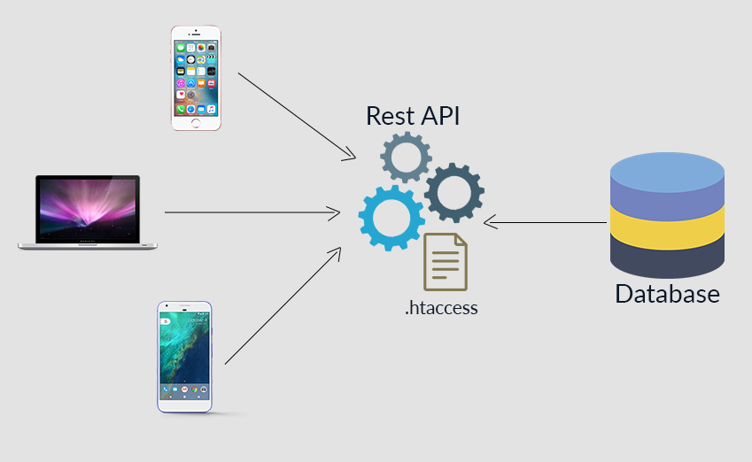
CHALLENGES

